Slide 1

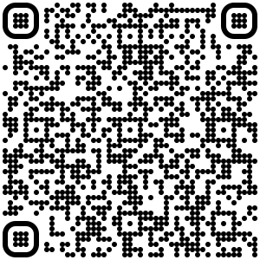
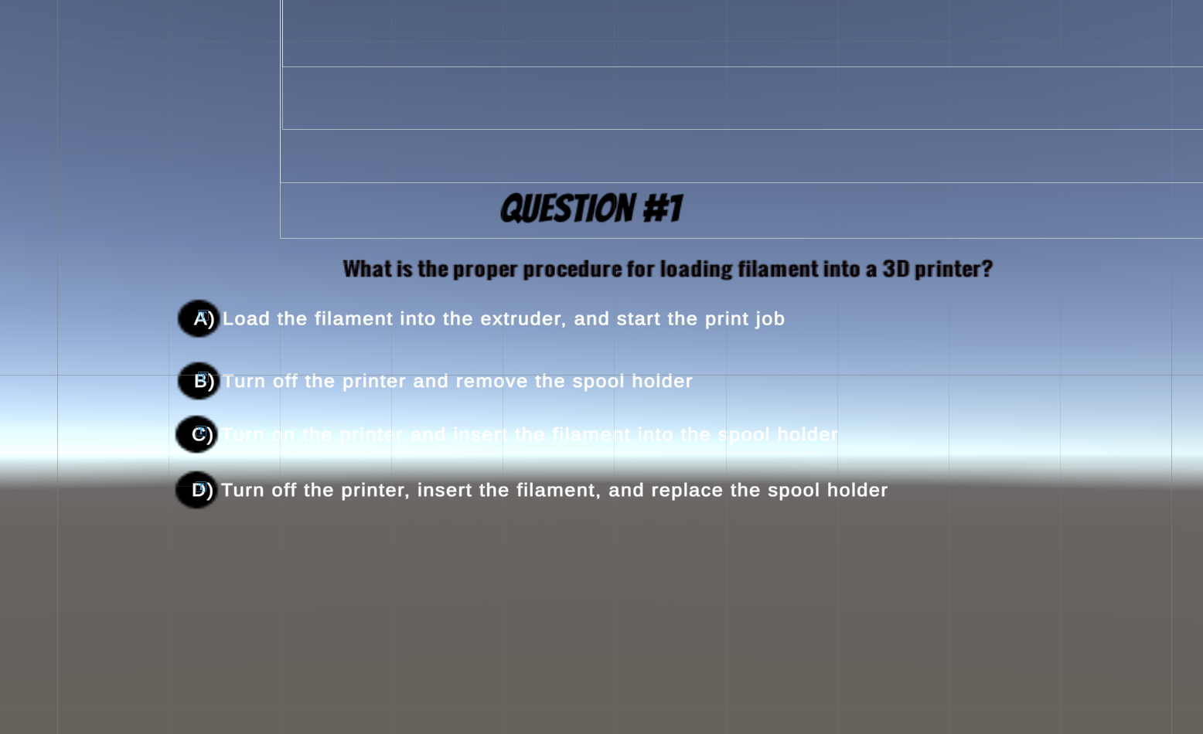
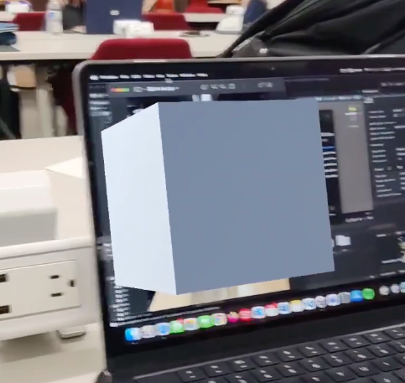
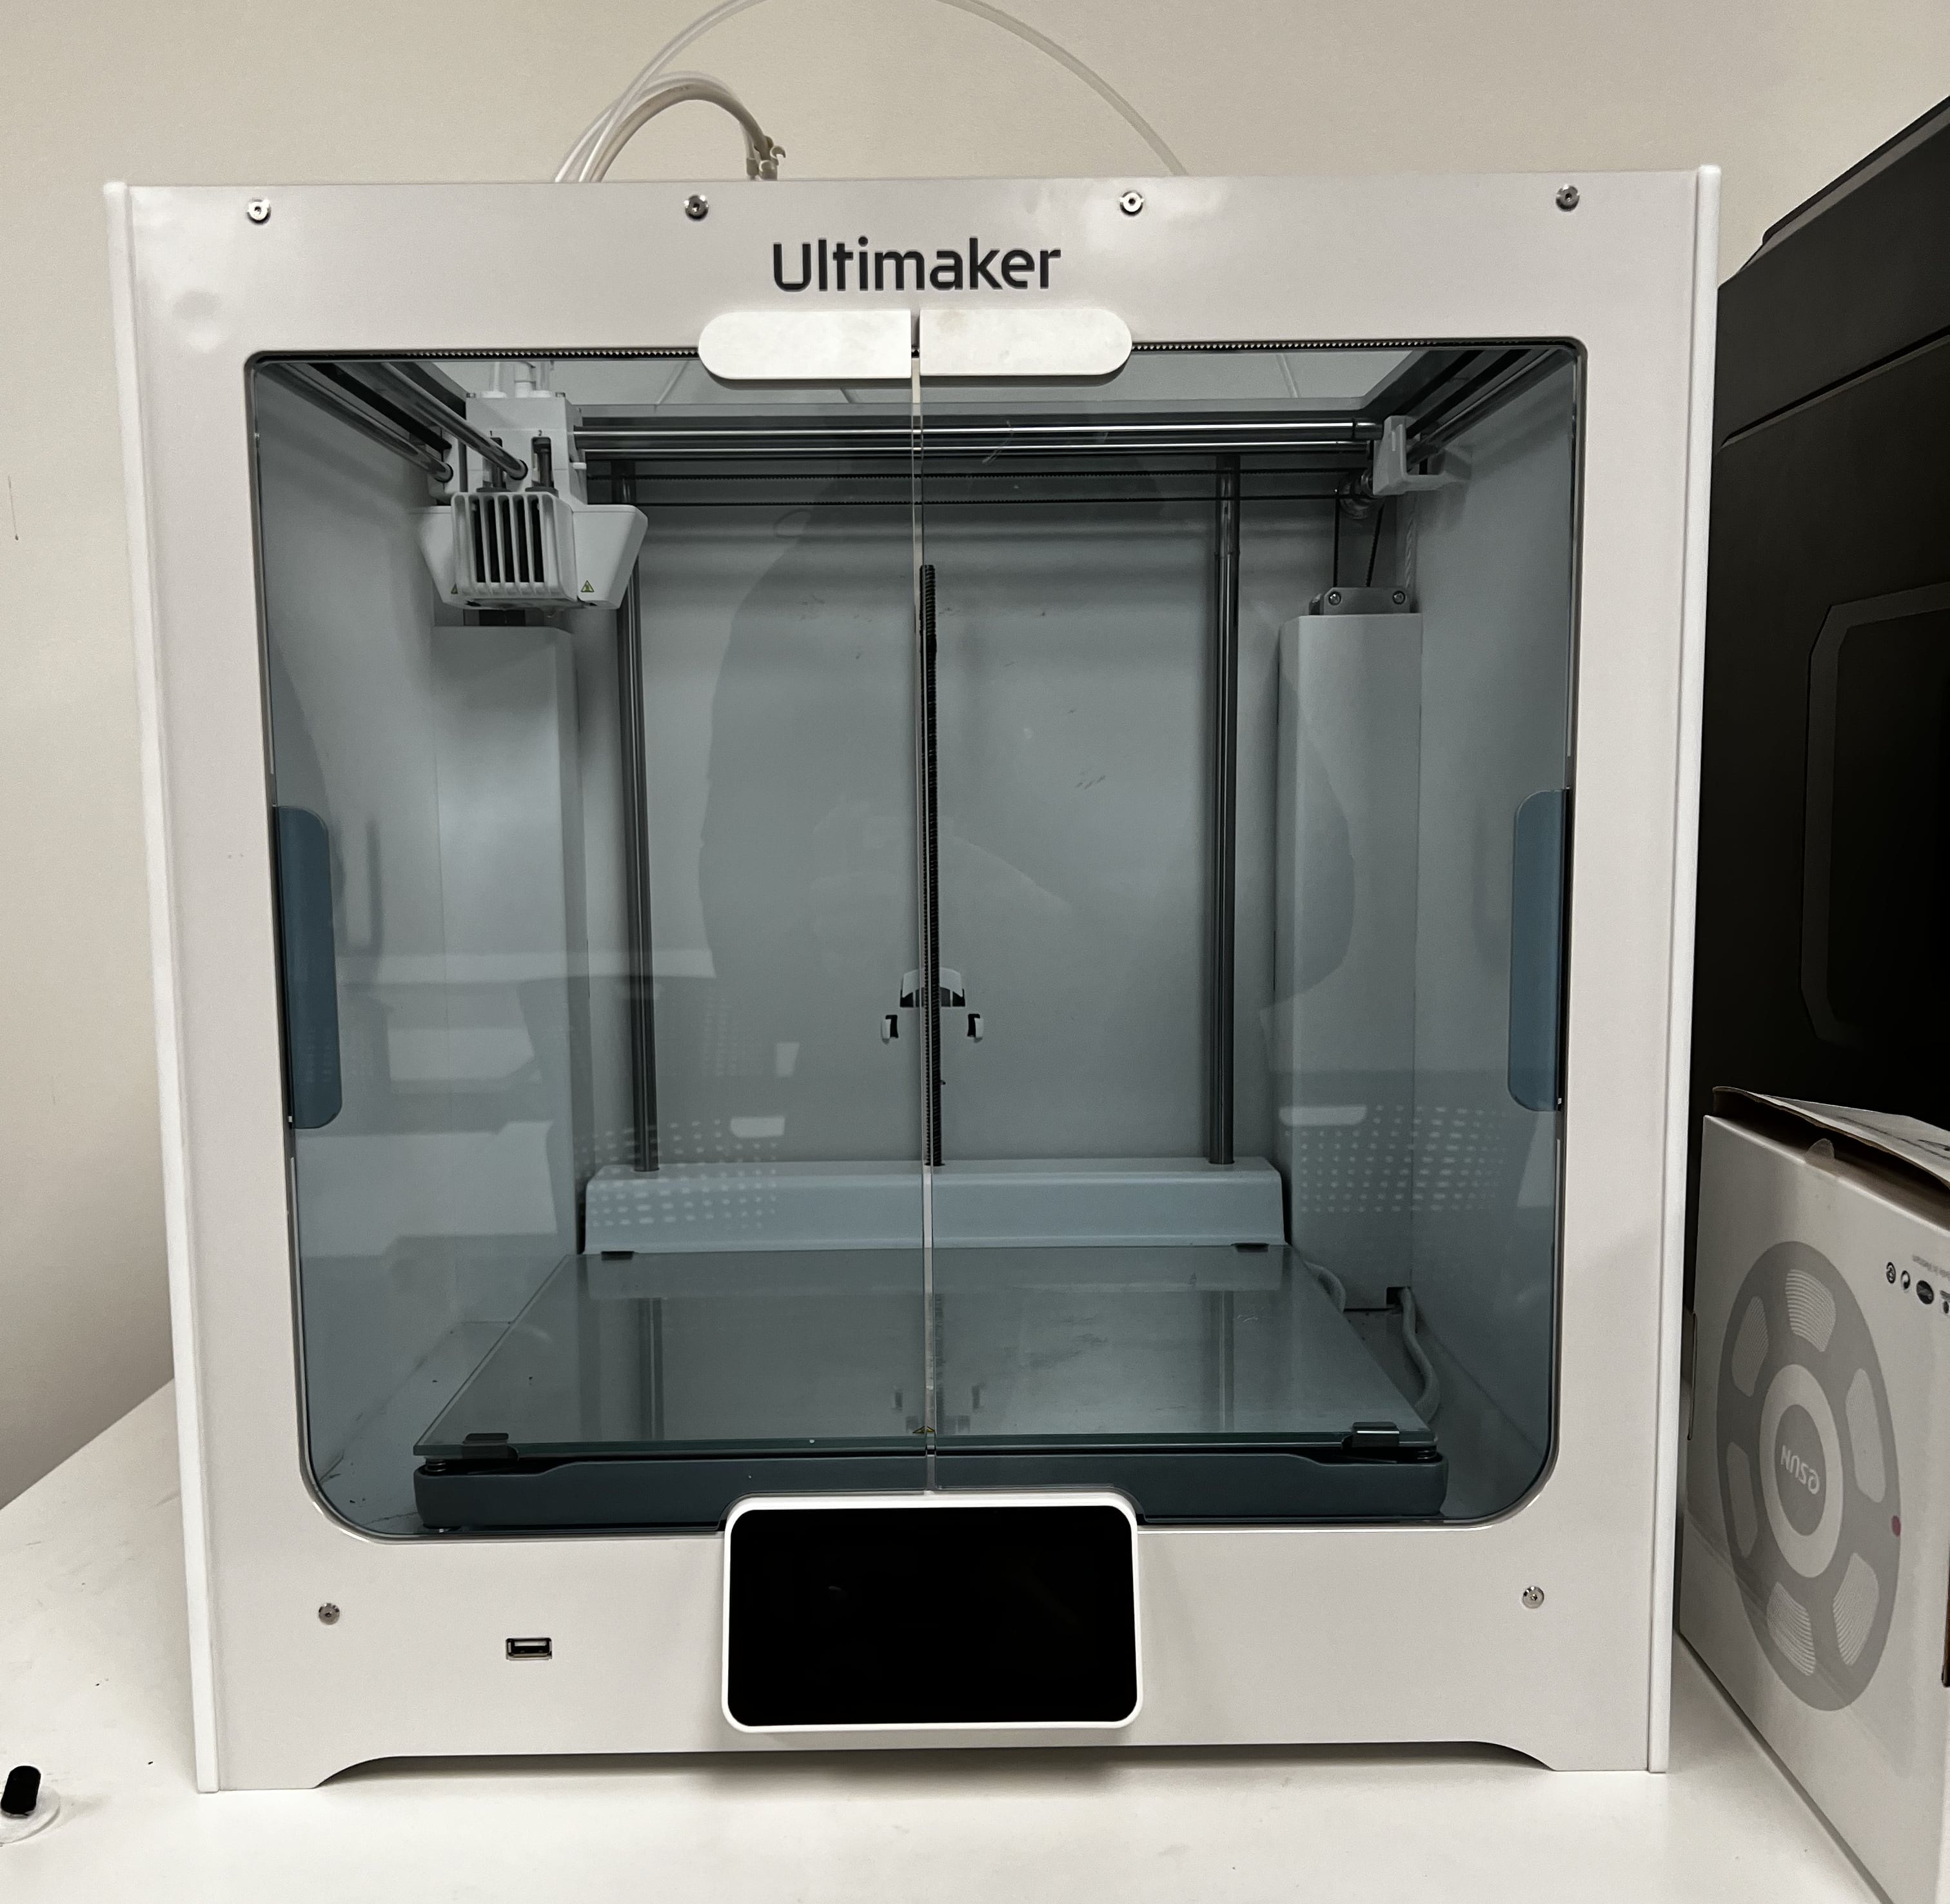
Developing An Augmented Reality Platform to Self-Educate in a Makerspace
Raja Allmdar Tariq Ali , Nikhil Anand Dhoka, Faiza Mukhtar, Sarah Papabathini,
Sevinch Pasilova, and Jonathan Taylor
Mentored by Christian Rogers, Ph.D. and Alan Jones, Ph.D.
Purdue School of Engineering and Technology
Indiana University-Purdue University Indianapolis
Abstract
Material and Methods
Results continued
Our project aimed to develop an Augmented Reality (AR) platform using a 3D printed Headset Mobile Harness for self-education in makerspaces. We created an AR application that offers a tutorial on how to use a 3D printer, catering to visual and tactile learners. Our team worked on developing an Image Detection feature to provide learners with a tutorial. Additionally, we integrated a quiz to check the user's knowledge. Our findings indicated that individual features are functional, and the next step is to integrate them into a fully functional AR application to conduct usability testing. This project demonstrates the potential of VR and AR technologies in education to enhance the learning experience.
To address the research question, our team decided to use the Unity game development platform and Google Pixel to run the software. The Headset was already provided to us by the previous summer MURI team. The software was also adapted to run on a Google Pixel.
Link to a video demonstration of the Image Detection:
Results
Quiz
Conclusions
Software: our team was able to build features for the AR Application from scratch that included Image Detection and a Quiz element. We also conducted a usability testing on the mobile harness that would allow for further development.
Future Research:
Find ways to make the goggles more user friendly
Integrate features into seamless Augmented Reality (AR) application.
To replicate the application for multiple tools in the makerspace to get a wider user feedback.
To include a collaborative environment using AR Core Cloud anchors.
Introduction
Image Detection
Research Question: What features can we integrate into our AR application to aid the learning experience?
We developed Image Detection and a quiz feature for an AR app using Unity, testing their effectiveness in enhancing self-education through test demos. Our report outlines the development process, features, and findings, demonstrating AR's potential to revolutionize the learning experience by replacing real-world images with virtual objects and testing users' knowledge in a makerspace. Our project showcases the potential of AR technology in education and encourages further exploration of its applications in learning environments.
References
Mayer, R. E., & Moreno, R. (2003). Nine ways to reduce cognitive load in multimedia learning.
Kosterelioglu, Ilker. (2016). Student Views on Learning Environments Enriched by Video Clips.
Hwang, G. J., Chen, N. S., & Tsai, C. C. (2014). The effects of collaborative learning with augmented reality on problem-solving ability.

